Slide 1
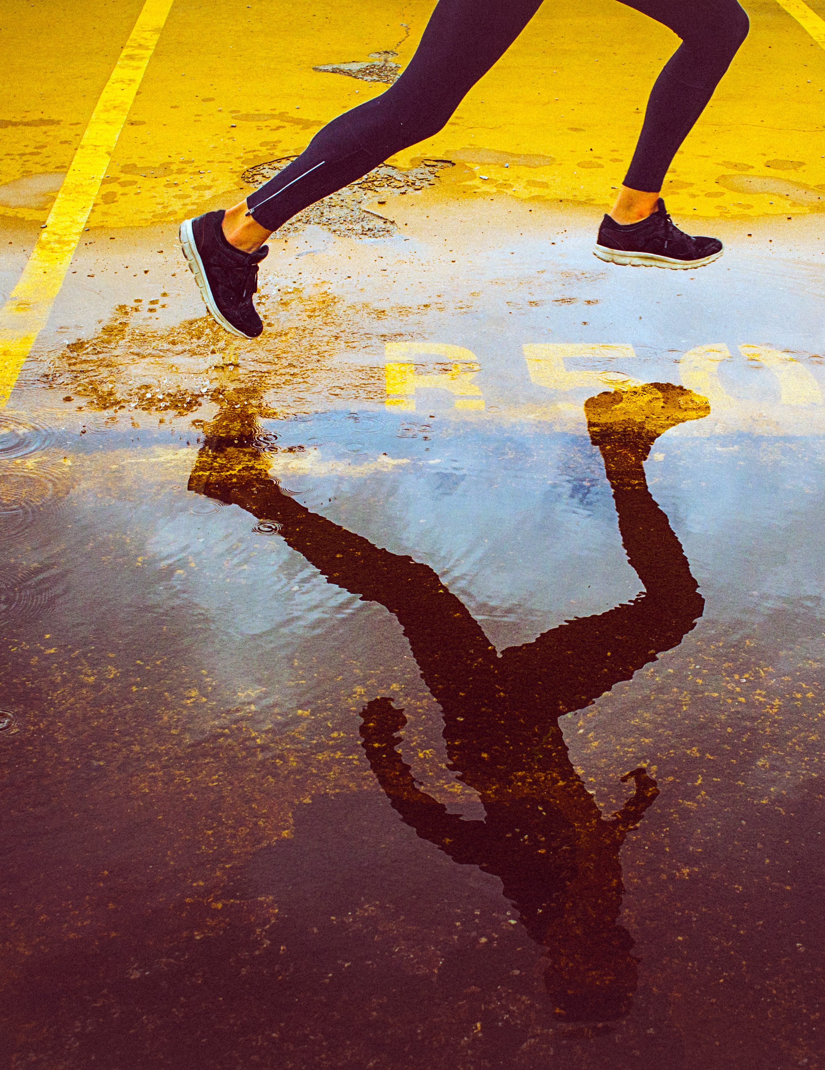
Waking for good health
first presentation
Chau Thanh sang

Slide 2
On this presentation
Health benefits of walking
Walking in right posture
Making walking a pleasure

Slide 3
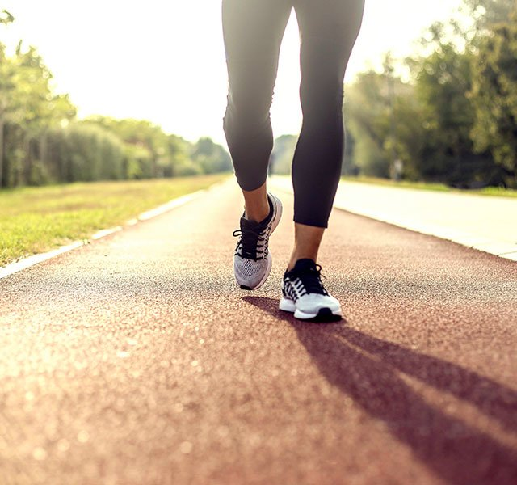
Health benefits of walking
Reduce body fat.
Increased muscle strength and endurance.
Reduced risk of heart disease and stroke.
Improved management of conditions such as high blood pressure, high cholesterol…

Slide 4
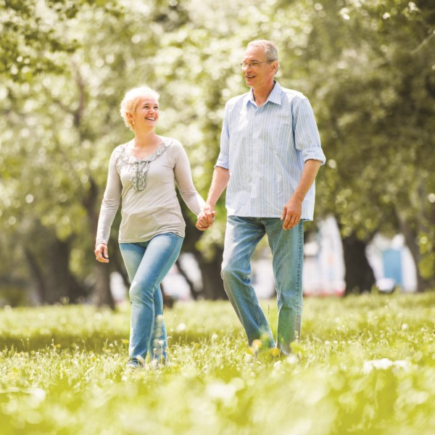
Health benefits of walking
Relieves stress and enhance mood.
Erase sadness, make happy.

Slide 5
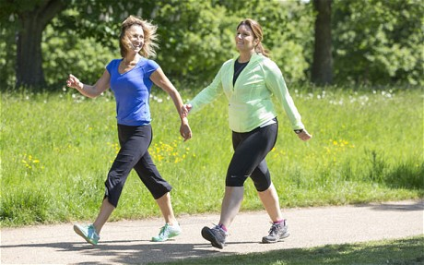
Walking in right posture
Walk smoothly.
A comfortable intensity for walking.
Warming up and cooling down after walking.

Slide 6
Walking in right posture
Walking is a low-cost and effective form of exercise.
The wrong type of shoe or walking action can cause foot or shin pain, blisters and injuries to soft tissue.
Shoes are comfortable, with appropriate heel and arch supports.

Slide 7

Making walking a pleasure
Walking for 30 minutes a day.
Even a “little is good, but more is better”.
Building physical activity into your life.
Take the stairs instead of the lift.
Walk to the local shops.
Get off public transport one stop earlier.
Walk the dog.

Slide 8
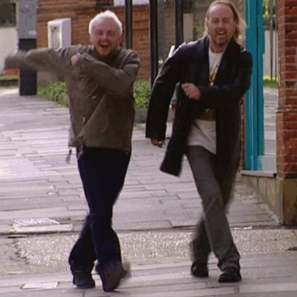
Making walking a pleasure
Varying where you walk.
Walking the dog.
Walking with friends.

Slide 9
Thank you!

